Slide 1
Stoneham Public Schools
November 2, 2023
McKibben Demographic Research, LLC
Jerome McKibben, Ph.D.
Rock Hill, SC j.mckibben@mckibbendemographics.com
978-501-7069

Slide 2
Stoneham Public Schools Forecast Assumptions
The national, state or regional economy does not go into deep recession at anytime during the 10 years of the forecasts; (Deep recession is defined as four consecutive quarters where the GDP contracts greater than 1% per quarter)
Interest rates have risen from their historic lows and will not fluctuate more than two percentage points in the short term; the interest rate for a 30-year fixed home mortgage stays between 5.5% and 7.5% for the 10 years of the forecasts;
The rate of mortgage approval stays at 2023 levels and lenders do not return to “sub-prime” mortgage practices;
There are no additional restrictions placed on home mortgage lenders or additional bankruptcies of major credit providers;
The rate of housing foreclosures does not exceed 125% of the 2015-2022 average of Middlesex County for any year in the forecasts;
All currently planned, platted, approved, and permitted housing developments are built out and completed by 2032. All new housing units constructed are occupied by 2033. Speculative new home construction plans are not included;
The average annual unemployment rates for the Middlesex County and the Boston Metropolitan Area will remain below 7.5% for the 10 years of the forecasts;
The intra-district student transfer policy remains unchanged over the next 10 years;
The rate of students transferring out of the Stoneham Public Schools will remain at the AY2018-19 to AY2022-23 average;
The inflation rate for gasoline will stay below 5% per year for the 10 years of the forecasts;

Slide 3
Stoneham Public Schools Forecast Assumptions
The state of Massachusetts does not change the current policy on open enrollment (unrestricted inter district transfers) or school vouchers anytime in the next 10 years;
There will be no building moratorium within the district;
Businesses within the district and the Stoneham Public Schools area will remain viable;
There are no new charter schools opened in the district anytime or expansion of existing charter schools over the next 10 years;
The number of existing home sales in the district that are a result of “distress sales” (homes worth less than the current mortgage value) will not exceed 20% of total homes sales in the district for any given year;
Housing turnover rates (sale of existing homes in the district) will remain at their current levels. The majority of existing homes sold are those of homeowners over the age of 60;
The district will have at least an average of 240 existing home sales per year for the next 10 years;
The district will have at least an average of 80 new single-family housing units constructed per year over the next 10 years;
Private school and home school attendance rates will remain constant at AY2023 levels;
The rate of foreclosures for commercial property remains at the 2015-2022 average for Middlesex County;
The number of students engaging in virtual learning (both within and outside of the district) remains at the AY2023 level.

Slide 4
Stoneham Public Schools Total Population – 2020 Census

Slide 5
Colonial Park Elementary School – 2020 Census

Slide 6
Robin Hood Elementary School – 2020 Census

Slide 7
South Elementary School – 2020 Census

Slide 8
Stoneham Public Schools Supplemental Tables
Table 2: Household Characteristics by Elementary Area, 2020 Census
 | HH w/ Pop Under 18 | % HH w/ Pop Under 18 | Total Households | Household Population | Persons Per Household
Colonial Park | 550 | 28.9% | 1,902 | 5,004 | 2.63
Robin Hood | 832 | 23.4% | 3,550 | 8,068 | 2.27
South | 1,110 | 25.5% | 4,356 | 10,094 | 2.32
District Total | 2,491 | 25.4% | 9,808 | 23,166 | 2.36

Slide 9
Stoneham Public Schools Supplemental Tables
Table 3: Householder Characteristics by Elementary Area, 2020 Census
 | Percentage of Householders aged 35-54 | Percentage of Householders aged 65+ | Percentage of Householders who own homes
Colonial Park | 33.9% | 34.6% | 84.4%
Robin Hood | 31.5% | 36.2% | 64.9%
South | 35.9% | 28.6% | 59.0%
District Total | 33.9% | 32.5% | 66.0%

Slide 10
Stoneham Public Schools Supplemental Tables
Table 4: Percentage of Households that are Single Person Households and Single Person Households that are over age 65 by Elementary Area, 2020 Census
 | Percentage of Single Person Households | Percentage of Single Person Households and are 65+
Colonial Park | 24.8% | 13.2%
Robin Hood | 34.6% | 18.0%
South | 31.3% | 13.9%
District Total | 31.2% | 15.2%

Slide 11
Stoneham Public Schools Supplemental Tables
Table 6: Age Under One to Age Ten Population Counts, by Year of Age,
by Elementary Area: 2020 Census
 | Under 1 year | 1 year | 2 years | 3 years | 4 years | 5 years | 6 years | 7 years | 8 years | 9 years | 10 years
Colonial Park | 62 | 47 | 53 | 45 | 43 | 47 | 43 | 55 | 60 | 53 | 54
Robin Hood | 73 | 109 | 88 | 89 | 80 | 80 | 67 | 81 | 75 | 53 | 84
South | 111 | 129 | 116 | 118 | 105 | 93 | 102 | 92 | 93 | 85 | 78
District Total | 246 | 285 | 257 | 252 | 228 | 220 | 212 | 227 | 227 | 191 | 216

Slide 12
Stoneham Public Schools Supplemental Tables
Comparison of District Resident Enrollment by Grade with 2020 Census Counts by Age,
2020-23
2020 Census | Under 1 year | 1 year | 2 years | 3 years | 4 years | 5 years | 6 years | 7 years | 8 years | 9 years | 10 years | 11 years | 12 years | 13 years
Stoneham Public Schools | 246 | 285 | 257 | 252 | 228 | 220 | 212 | 227 | 227 | 191 | 216 | 221 | 221 | 238
2023 |  |  | 200 | 186 | 179 | 187 | 166 | 178 | 156 | 186 | 180 | 129 | 161 | 142
Enrollment |  |  | 77.8% | 73.8% | 78.5% | 85.0% | 78.3% | 78.4% | 68.7% | 97.4% | 83.3% | 58.4% | 72.9% | 59.7%
2022 |  |  |  | 182 | 186 | 187 | 165 | 176 | 162 | 186 | 177 | 153 | 174 | 144
Enrollment |  |  |  | 72.2% | 81.6% | 85.0% | 77.8% | 77.5% | 71.4% | 97.4% | 81.9% | 69.2% | 78.7% | 60.5%
2021 |  |  |  |  | 169 | 186 | 167 | 178 | 166 | 181 | 172 | 157 | 199 | 144
Enrollment |  |  |  |  | 74.1% | 84.5% | 78.8% | 78.4% | 73.1% | 94.8% | 79.6% | 71.0% | 90.0% | 60.5%
2020 |  |  |  |  |  | 172 | 173 | 174 | 176 | 181 | 176 | 163 | 197 | 172
Enrollment |  |  |  |  |  | 78.2% | 81.6% | 76.7% | 77.5% | 94.8% | 81.5% | 73.8% | 89.1% | 72.3%

Slide 13
Where PK-4 Students Live Versus Where They Attend School

Slide 14
Stoneham Public Schools District Population Forecast
 |  | 2020 |  | 2025 |  | 2030 |  | 2035
0-4 |  | 1268 |  | 1240 |  | 1210 |  | 1150
5-9 |  | 1077 |  | 1310 |  | 1370 |  | 1400
10-14 |  | 1103 |  | 1110 |  | 1330 |  | 1380
15-19 |  | 1084 |  | 1040 |  | 1040 |  | 1270
20-24 |  | 1132 |  | 990 |  | 940 |  | 950
25-29 |  | 1344 |  | 1160 |  | 1030 |  | 970
30-34 |  | 1697 |  | 1440 |  | 1260 |  | 1140
35-39 |  | 1719 |  | 1820 |  | 1520 |  | 1360
40-44 |  | 1510 |  | 1750 |  | 1840 |  | 1530
45-49 |  | 1349 |  | 1490 |  | 1730 |  | 1830
50-54 |  | 1602 |  | 1340 |  | 1490 |  | 1710
55-59 |  | 1739 |  | 1570 |  | 1310 |  | 1440
60-64 |  | 1725 |  | 1710 |  | 1530 |  | 1270
65-69 |  | 1501 |  | 1630 |  | 1590 |  | 1430
70-74 |  | 1217 |  | 1420 |  | 1530 |  | 1460
75-79 |  | 842 |  | 1220 |  | 1430 |  | 1510
80-84 |  | 605 |  | 820 |  | 1180 |  | 1400
85+ |  | 730 |  | 760 |  | 880 |  | 1130
Total |  | 23244 |  | 23820 |  | 24210 |  | 24330
Median Age |  | 44.0 |  | 45.2 |  | 46.6 |  | 47.8
Births |  |  | 1150 |  | 1050 |  | 1010
Deaths |  |  | 900 |  | 1030 |  | 1250
Natural Increase |  |  | 250 |  | 20 |  | -240
Net Migration |  |  | 300 |  | 330 |  | 350
Change |  |  | 550 |  | 350 |  | 110

Slide 15
Stoneham Public Schools Total Enrollment
 | 2020-21 | 2021-22 | 2022-23 | 2023-24 | 2024-25 | 2025-26 | 2026-27 | 2027-28 | 2028-29 | 2029-30 | 2030-31 | 2031-32 | 2032-33 | 2033-34
PK | 60 | 89 | 87 | 86 | 86 | 86 | 86 | 86 | 86 | 86 | 86 | 86 | 86 | 86
K | 172 | 169 | 182 | 200 | 201 | 203 | 203 | 199 | 196 | 199 | 203 | 207 | 210 | 207
1 | 173 | 186 | 186 | 186 | 208 | 209 | 211 | 209 | 205 | 202 | 205 | 208 | 212 | 215
2 | 174 | 167 | 187 | 179 | 180 | 202 | 204 | 206 | 204 | 200 | 197 | 200 | 203 | 207
3 | 176 | 178 | 165 | 187 | 175 | 176 | 199 | 201 | 203 | 201 | 198 | 195 | 198 | 201
4 | 181 | 166 | 176 | 166 | 182 | 170 | 174 | 197 | 199 | 201 | 199 | 196 | 193 | 196
Total PK-4 | 936 | 955 | 983 | 1004 | 1032 | 1046 | 1077 | 1098 | 1093 | 1089 | 1088 | 1092 | 1102 | 1112
5 | 176 | 181 | 162 | 178 | 168 | 184 | 172 | 176 | 199 | 201 | 203 | 201 | 198 | 195
6 | 163 | 172 | 186 | 156 | 174 | 165 | 180 | 169 | 172 | 195 | 197 | 199 | 197 | 194
7 | 197 | 157 | 177 | 186 | 154 | 172 | 163 | 178 | 167 | 170 | 193 | 195 | 197 | 195
8 | 172 | 199 | 153 | 180 | 184 | 152 | 170 | 161 | 176 | 165 | 168 | 191 | 193 | 195
Total: 5-8 | 708 | 709 | 678 | 700 | 680 | 673 | 685 | 684 | 714 | 731 | 761 | 786 | 785 | 779
9 | 148 | 144 | 174 | 129 | 166 | 169 | 141 | 160 | 151 | 165 | 155 | 158 | 180 | 181
10 | 145 | 148 | 144 | 161 | 126 | 163 | 166 | 138 | 157 | 148 | 162 | 152 | 155 | 176
11 | 139 | 146 | 152 | 142 | 159 | 125 | 161 | 164 | 137 | 155 | 147 | 160 | 150 | 153
12 | 178 | 139 | 144 | 150 | 139 | 156 | 123 | 158 | 161 | 134 | 152 | 144 | 157 | 147
13 | 0 | 2 | 5 | 3 | 3 | 3 | 3 | 3 | 3 | 3 | 3 | 3 | 3 | 3
Total: 9-13 | 610 | 579 | 619 | 585 | 593 | 616 | 594 | 623 | 609 | 605 | 619 | 617 | 645 | 660
Total PK-13 | 2254 | 2243 | 2280 | 2289 | 2305 | 2335 | 2356 | 2405 | 2416 | 2425 | 2468 | 2495 | 2532 | 2551
Total PK-13 | 2254 | 2243 | 2280 | 2289 | 2305 | 2335 | 2356 | 2405 | 2416 | 2425 | 2468 | 2495 | 2532 | 2551
Change |  | -11 | 37 | 9 | 16 | 30 | 21 | 49 | 11 | 9 | 43 | 27 | 37 | 19
%-Change |  | -0.5% | 1.65% | 0.39% | 0.70% | 1.30% | 0.90% | 2.08% | 0.46% | 0.37% | 1.77% | 1.09% | 1.48% | 0.75%
Total: PK-4 | 936 | 955 | 983 | 1004 | 1032 | 1046 | 1077 | 1098 | 1093 | 1089 | 1088 | 1092 | 1102 | 1112
Change |  | 19 | 28 | 21 | 28 | 14 | 31 | 21 | -5 | -4 | -1 | 4 | 10 | 10
%-Change |  | 2.03% | 2.93% | 2.14% | 2.79% | 1.36% | 2.96% | 1.95% | -0.5% | -0.4% | -0.1% | 0.37% | 0.92% | 0.91%
Total: 5-8 | 708 | 709 | 678 | 700 | 680 | 673 | 685 | 684 | 714 | 731 | 761 | 786 | 785 | 779
Change |  | 1 | -31 | 22 | -20 | -7 | 12 | -1 | 30 | 17 | 30 | 25 | -1 | -6
%-Change |  | 0.14% | -4.4% | 3.24% | -2.9% | -1.0% | 1.78% | -0.2% | 4.39% | 2.38% | 4.10% | 3.29% | -0.1% | -0.8%
Total: 9-13 | 610 | 579 | 619 | 585 | 593 | 616 | 594 | 623 | 609 | 605 | 619 | 617 | 645 | 660
Change |  | -31 | 40 | -34 | 8 | 23 | -22 | 29 | -14 | -4 | 14 | -2 | 28 | 15
%-Change |  | -5.2% | 6.91% | -5.5% | 1.37% | 3.88% | -3.6% | 4.88% | -2.3% | -0.7% | 2.31% | -0.3% | 4.54% | 2.33%

Slide 16
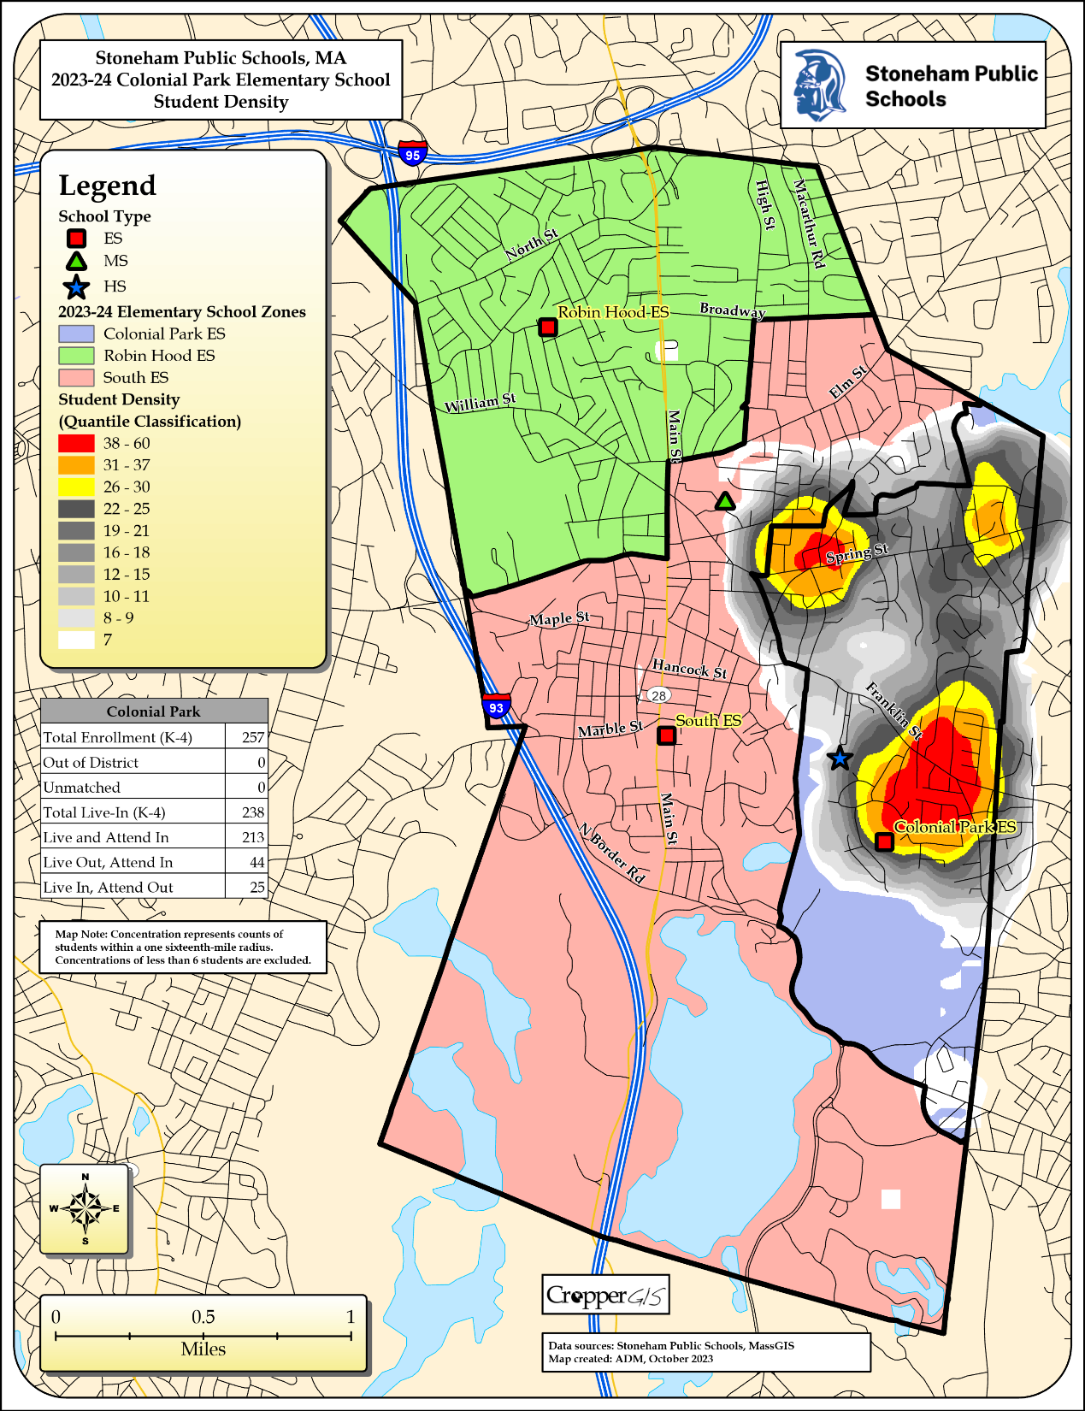

Slide 17
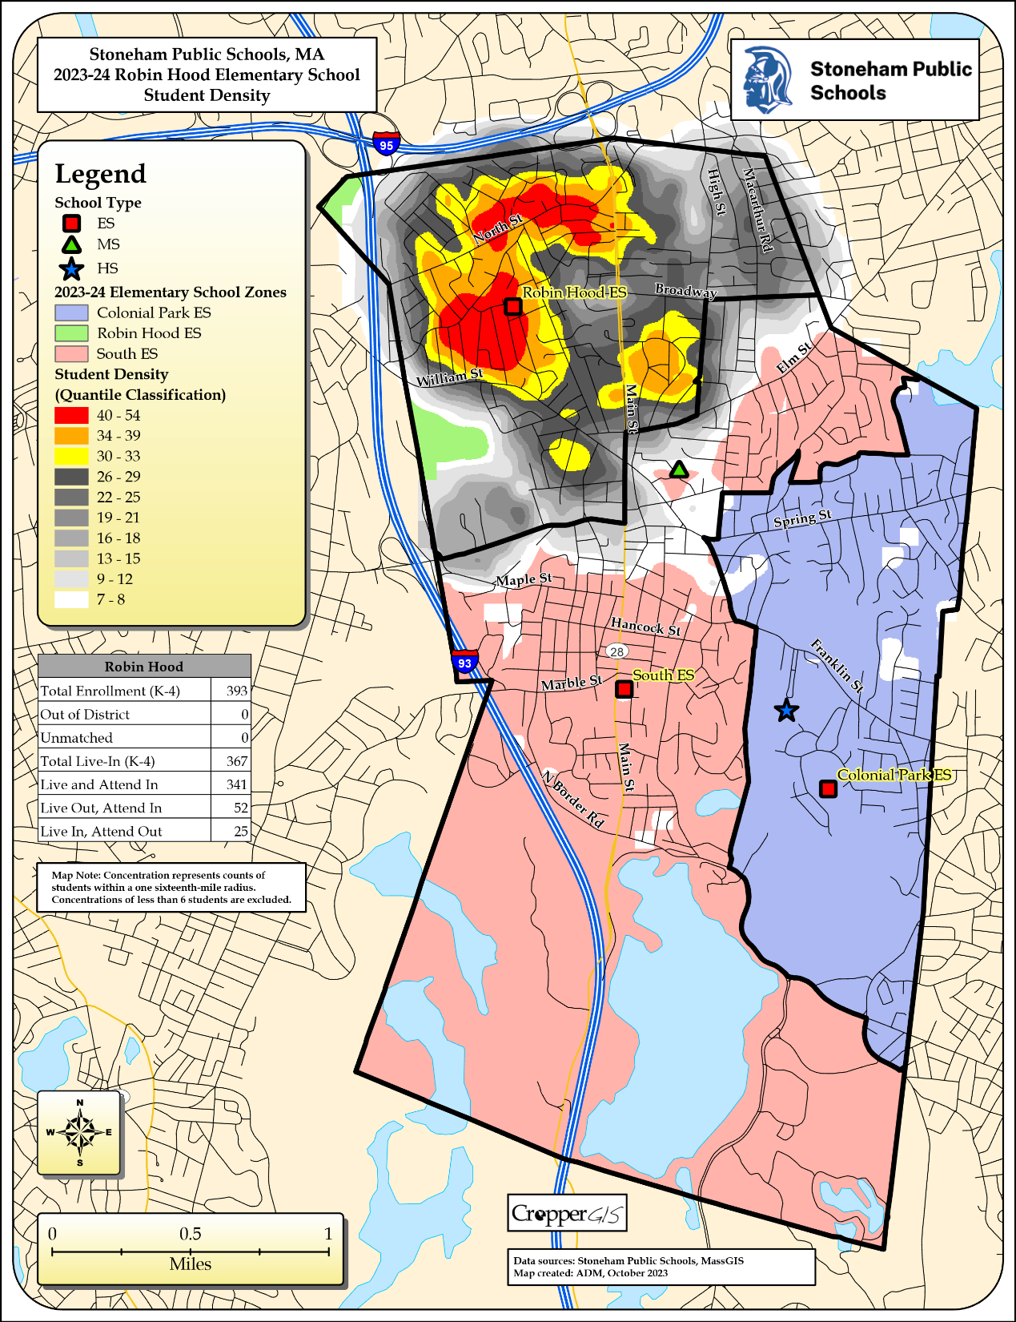

Slide 18
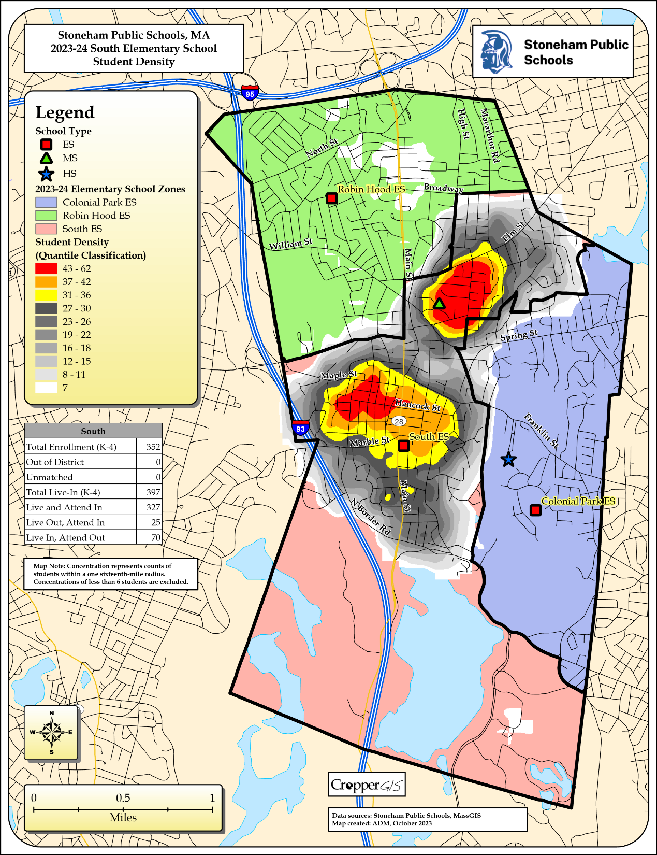

Slide 19
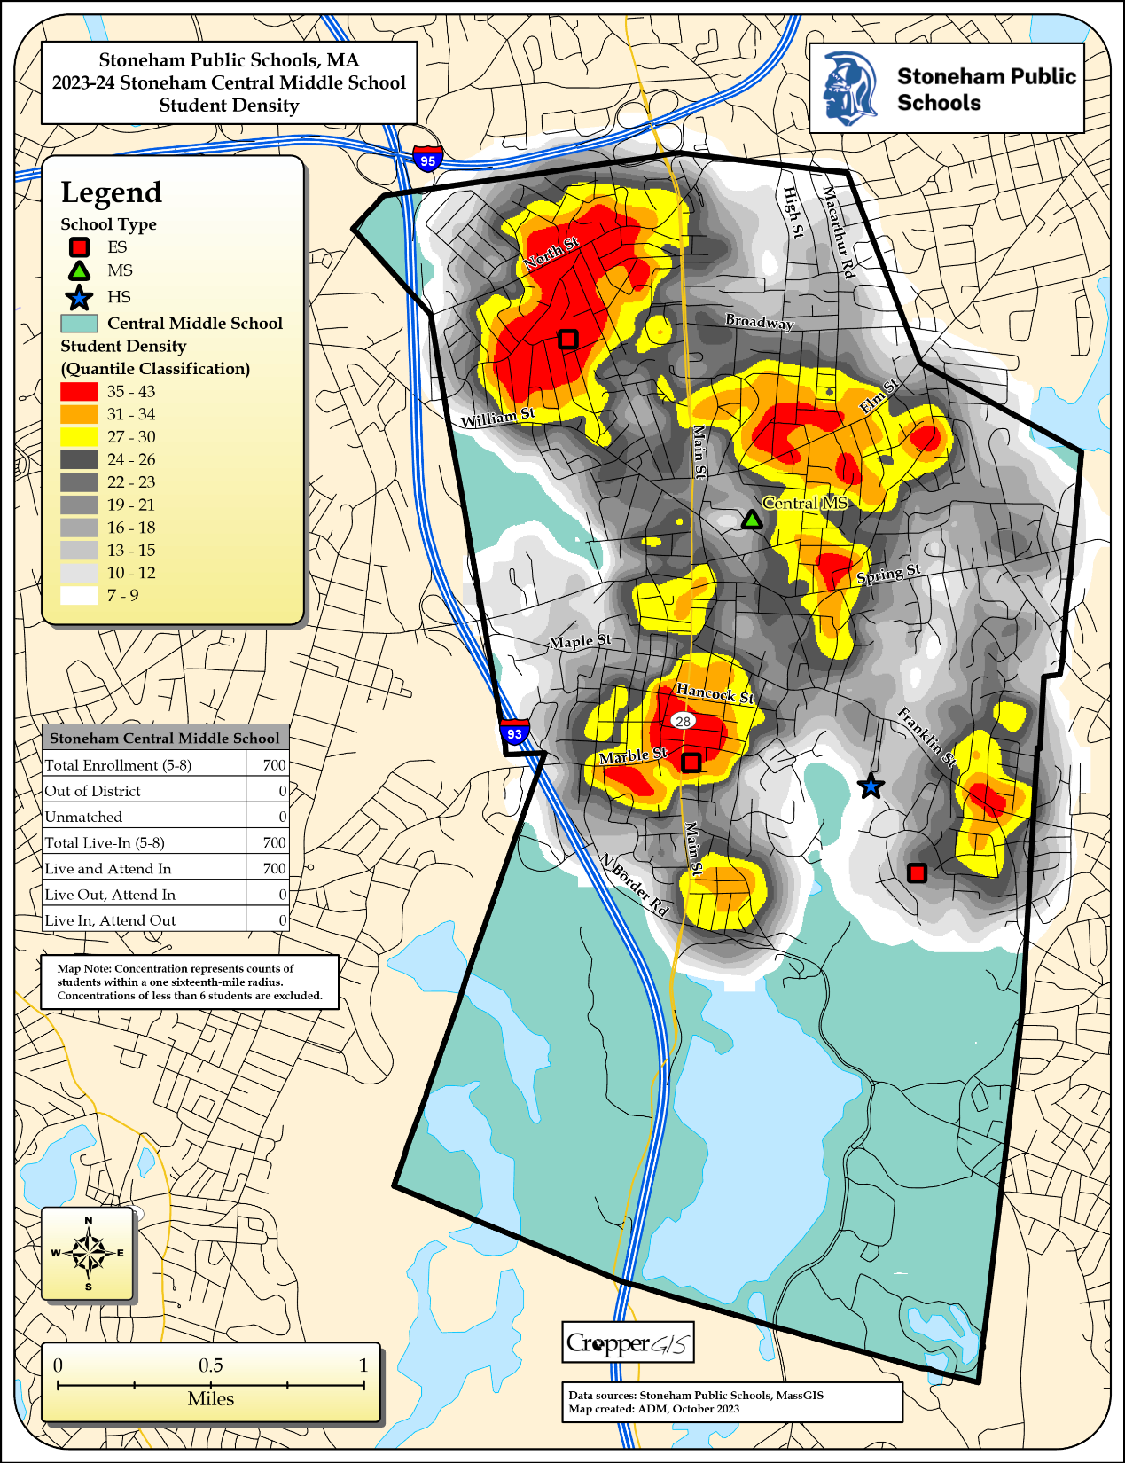

Slide 20
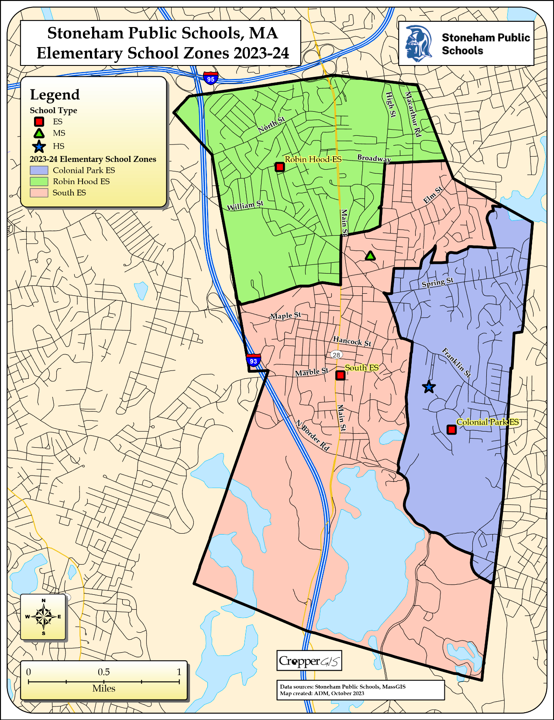

Slide 21
Colonial Park Elementary Total Enrollment
 | 2020-21 | 2021-22 | 2022-23 | 2023-24 | 2024-25 | 2025-26 | 2026-27 | 2027-28 | 2028-29 | 2029-30 | 2030-31 | 2031-32 | 2032-33 | 2033-34
PK | 25 | 32 | 26 | 32 | 32 | 32 | 32 | 32 | 32 | 32 | 32 | 32 | 32 | 32
K | 46 | 39 | 36 | 48 | 48 | 48 | 47 | 46 | 44 | 45 | 47 | 48 | 49 | 48
1 | 44 | 49 | 46 | 41 | 52 | 51 | 51 | 50 | 49 | 47 | 48 | 49 | 50 | 51
2 | 43 | 43 | 46 | 44 | 40 | 51 | 50 | 50 | 49 | 48 | 46 | 47 | 48 | 49
3 | 48 | 44 | 46 | 47 | 45 | 41 | 52 | 51 | 51 | 50 | 49 | 47 | 48 | 49
4 | 45 | 44 | 41 | 45 | 44 | 42 | 39 | 50 | 49 | 49 | 48 | 47 | 45 | 46
Total PK-4 | 251 | 251 | 241 | 257 | 261 | 265 | 271 | 279 | 274 | 271 | 270 | 270 | 272 | 275
Total: PK-4 | 251 | 251 | 241 | 257 | 261 | 265 | 271 | 279 | 274 | 271 | 270 | 270 | 272 | 275
Change |  | 0 | -10 | 16 | 4 | 4 | 6 | 8 | -5 | -3 | -1 | 0 | 2 | 3
%-Change |  | 0.00% | -4.0% | 6.64% | 1.56% | 1.53% | 2.26% | 2.95% | -1.8% | -1.1% | -0.4% | 0.00% | 0.74% | 1.10%

Slide 22
Robin Hood Elementary Total Enrollment
 | 2020-21 | 2021-22 | 2022-23 | 2023-24 | 2024-25 | 2025-26 | 2026-27 | 2027-28 | 2028-29 | 2029-30 | 2030-31 | 2031-32 | 2032-33 | 2033-34
PK | 16 | 36 | 28 | 23 | 23 | 23 | 23 | 23 | 23 | 23 | 23 | 23 | 23 | 23
K | 71 | 72 | 76 | 85 | 84 | 85 | 86 | 85 | 83 | 84 | 85 | 86 | 87 | 86
1 | 68 | 71 | 75 | 74 | 87 | 87 | 88 | 88 | 87 | 85 | 86 | 87 | 88 | 89
2 | 67 | 67 | 73 | 70 | 71 | 84 | 84 | 85 | 85 | 84 | 82 | 83 | 84 | 85
3 | 61 | 72 | 67 | 71 | 68 | 69 | 82 | 82 | 83 | 83 | 82 | 80 | 81 | 82
4 | 74 | 62 | 74 | 70 | 70 | 67 | 68 | 81 | 81 | 82 | 82 | 81 | 79 | 80
Total PK-4 | 357 | 380 | 393 | 393 | 403 | 415 | 431 | 444 | 442 | 441 | 440 | 440 | 442 | 445
Total: PK-4 | 357 | 380 | 393 | 393 | 403 | 415 | 431 | 444 | 442 | 441 | 440 | 440 | 442 | 445
Change |  | 23 | 13 | 0 | 10 | 12 | 16 | 13 | -2 | -1 | -1 | 0 | 2 | 3
%-Change |  | 6.44% | 3.42% | 0.00% | 2.54% | 2.98% | 3.86% | 3.02% | -0.5% | -0.2% | -0.2% | 0.00% | 0.45% | 0.68%

Slide 23
South Elementary Total Enrollment
 | 2020-21 | 2021-22 | 2022-23 | 2023-24 | 2024-25 | 2025-26 | 2026-27 | 2027-28 | 2028-29 | 2029-30 | 2030-31 | 2031-32 | 2032-33 | 2033-34
PK | 19 | 21 | 33 | 31 | 31 | 31 | 31 | 31 | 31 | 31 | 31 | 31 | 31 | 31
K | 55 | 58 | 70 | 67 | 69 | 70 | 70 | 68 | 69 | 70 | 71 | 73 | 74 | 73
1 | 61 | 66 | 65 | 71 | 69 | 71 | 72 | 71 | 69 | 70 | 71 | 72 | 74 | 75
2 | 64 | 57 | 68 | 65 | 69 | 67 | 70 | 71 | 70 | 68 | 69 | 70 | 71 | 73
3 | 67 | 62 | 52 | 69 | 62 | 66 | 65 | 68 | 69 | 68 | 67 | 68 | 69 | 70
4 | 62 | 60 | 61 | 51 | 68 | 61 | 67 | 66 | 69 | 70 | 69 | 68 | 69 | 70
Total PK-4 | 328 | 324 | 349 | 354 | 368 | 366 | 375 | 375 | 377 | 377 | 378 | 382 | 388 | 392
Total: PK-4 | 328 | 324 | 349 | 354 | 368 | 366 | 375 | 375 | 377 | 377 | 378 | 382 | 388 | 392
Change |  | -4 | 25 | 5 | 14 | -2 | 9 | 0 | 2 | 0 | 1 | 4 | 6 | 4
%-Change |  | -1.2% | 7.72% | 1.43% | 3.95% | -0.5% | 2.46% | 0.00% | 0.53% | 0.00% | 0.27% | 1.06% | 1.57% | 1.03%

Slide 24
Stoneham Central Middle School Total Enrollment
 | 2020-21 | 2021-22 | 2022-23 | 2023-24 | 2024-25 | 2025-26 | 2026-27 | 2027-28 | 2028-29 | 2029-30 | 2030-31 | 2031-32 | 2032-33 | 2033-34
5 | 176 | 181 | 162 | 178 | 168 | 184 | 172 | 176 | 199 | 201 | 203 | 201 | 198 | 195
6 | 163 | 172 | 186 | 156 | 174 | 165 | 180 | 169 | 172 | 195 | 197 | 199 | 197 | 194
7 | 197 | 157 | 177 | 186 | 154 | 172 | 163 | 178 | 167 | 170 | 193 | 195 | 197 | 195
8 | 172 | 199 | 153 | 180 | 184 | 152 | 170 | 161 | 176 | 165 | 168 | 191 | 193 | 195
Total: 5-8 | 708 | 709 | 678 | 700 | 680 | 673 | 685 | 684 | 714 | 731 | 761 | 786 | 785 | 779
Total: 5-8 | 708 | 709 | 678 | 700 | 680 | 673 | 685 | 684 | 714 | 731 | 761 | 786 | 785 | 779
Change |  | 1 | -31 | 22 | -20 | -7 | 12 | -1 | 30 | 17 | 30 | 25 | -1 | -6
%-Change |  | 0.14% | -4.4% | 3.24% | -2.9% | -1.0% | 1.78% | -0.2% | 4.39% | 2.38% | 4.10% | 3.29% | -0.1% | -0.8%

Slide 25
Stoneham High School Total Enrollment
 | 2020-21 | 2021-22 | 2022-23 | 2023-24 | 2024-25 | 2025-26 | 2026-27 | 2027-28 | 2028-29 | 2029-30 | 2030-31 | 2031-32 | 2032-33 | 2033-34
9 | 148 | 144 | 174 | 129 | 166 | 169 | 141 | 160 | 151 | 165 | 155 | 158 | 180 | 181
10 | 145 | 148 | 144 | 161 | 126 | 163 | 166 | 138 | 157 | 148 | 162 | 152 | 155 | 176
11 | 139 | 146 | 152 | 142 | 159 | 125 | 161 | 164 | 137 | 155 | 147 | 160 | 150 | 153
12 | 178 | 139 | 144 | 150 | 139 | 156 | 123 | 158 | 161 | 134 | 152 | 144 | 157 | 147
13 | 0 | 2 | 5 | 3 | 3 | 3 | 3 | 3 | 3 | 3 | 3 | 3 | 3 | 3
Total: 9-13 | 610 | 579 | 619 | 585 | 593 | 616 | 594 | 623 | 609 | 605 | 619 | 617 | 645 | 660
Total: 9-13 | 610 | 579 | 619 | 585 | 593 | 616 | 594 | 623 | 609 | 605 | 619 | 617 | 645 | 660
Change |  | -31 | 40 | -34 | 8 | 23 | -22 | 29 | -14 | -4 | 14 | -2 | 28 | 15
%-Change |  | -5.1% | 6.91% | -5.5% | 1.37% | 3.88% | -3.6% | 4.88% | -2.3% | -0.7% | 2.31% | -0.3% | 4.54% | 2.33%

Slide 26
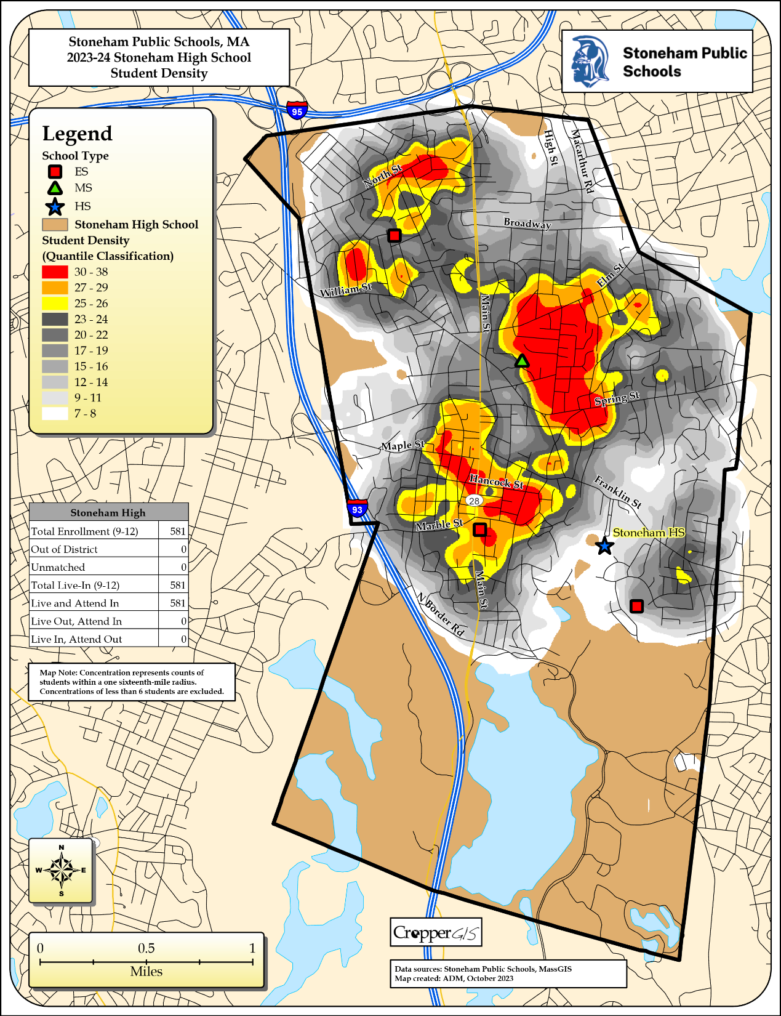

Slide 27
Stoneham Public Schools Supplemental Tables
Table 1: Forecasted Elementary Area Population Change, 2020 to 2030
 | 2020 | 2025 | 2020-2025 Change | 2030 | 2025-2030 Change | 2020-2030 Change
Colonial Park | 5,006 | 5,180 | 3.5% | 5,320 | 2.7% | 6.3%
Robin Hood | 8,079 | 8,200 | 1.5% | 8,270 | 0.9% | 2.4%
South | 10,159 | 10,440 | 2.8% | 10,620 | 1.7% | 4.5%
District Total | 23,244 | 23,820 | 2.5% | 24,210 | 1.6% | 4.2%

Slide 28
Stoneham Public Schools Supplemental Tables
Table 5: Elementary Enrollment (PK-4), 2023, 2028, 2033
 | 2023 | 2028 | 2023-2028 Change | 2033 | 2028-2033 Change | 2023-2033 Change
Colonial Park | 225 | 242 | 7.6% | 243 | 0.4% | 8.0%
Robin Hood | 370 | 419 | 13.2% | 422 | 0.7% | 14.1%
South | 323 | 346 | 7.1% | 361 | 4.3% | 11.8%
District Total | 918 | 1,007 | 9.7% | 1,026 | 1.9% | 11.8%

